Slide 1

ABC’s of Web Development with JavaScript
UTSA
Computer Science
Juan M. Valadez, Jr.

Slide 2
Brief History of JavaScript
Created in 1995 by Brendan Eich
Inspired by Java, Scheme and Self
“JavaScript” was a marketing ploy
Scripting language exclusively for the web

Slide 3
The purpose of JavaScript
Interactive
Access content
Modify content
Interesting
React to user events
User-friendly
Slideshows
Form and data validation
Reload of page

Slide 4
What is a JavaScript?
Client sided program
Run within the web browser
May be disabled by the end user
Series of instructions
May use one or all subset of instructions each time it is run
Allow to solve a task programmatically
Best when based on a flowchart
Event driven

Slide 5
How it all works together
HTML
Content Layer
Structure and semantics
CSS
Presentation Layer
JavaScript
Behavior Layer: interactivity

Slide 6
JavaScript Considerations
Written in plain text
Has a .js file extension
May be written inline with the HTML page
Should be kept in own source folder
“JS”
Using a JavaScript
<script> start tag
</script> end tag
src=“” attribute

Slide 7
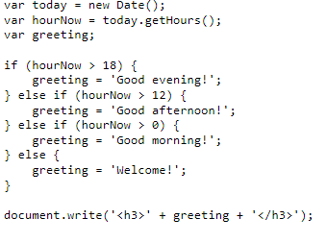
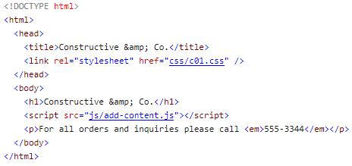
JavaScript Example
add-content.js
Index.html

Slide 8
Calling Objects & Methods
object
method
document.write(‘Good afternoon!’);
Member
Operator
Parameters

Slide 9
JavaScript Considerations
All scripts are run where they are found
Browser check if any action needs to be processed
May affect page load
Scripts my easily be downloaded
Scripts may be modified and reprocessed

